Slide 1
WATER FLOODING, INJECTION

Slide 2
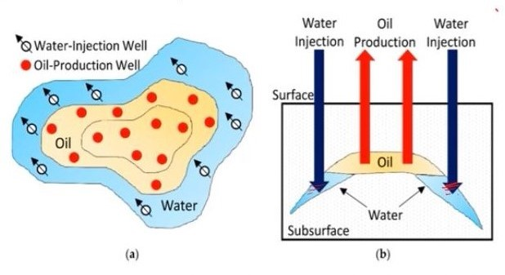
WATER INJECTION
Process of injection water into the aquifer.
To maintenance of reservoir pressure and for secondary recovery.
Disposal of production water or brine.
Water is Cheap, easily available, good displacing characteristics, coexists with oil, most of reservoir are water wet, high sweep efficiency and less treatment required.

Slide 3
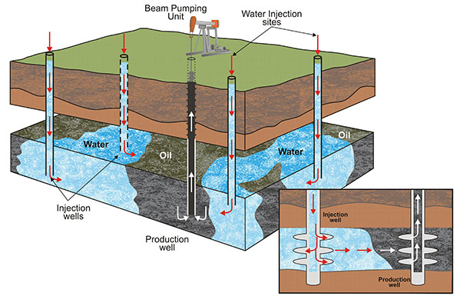
WATER FLOODING

Slide 4
INTRODUCTION
Water flooding has been most widely used secondary oil recovery method after the exhaustion of the primary depletion energy of the reservoir.
Water flooding basically involves pumping water through an injection well into the reservoir.
The water then forces itself through the pore spaces and sweeps the oil toward another set of wells known as producers.
As a result, there is an increment in the total oil production from the reservoir.
However, the percentage of water in the produced fluids steadily increases.
On the average, this process can lead to the recovery of about one-third of the Original Oil In Place (OOIP).

Slide 5
Factors Affecting Water Flooding
Reservoir geometry
Fluid properties
Reservoir depth
Petro-physical parameters
Fluid saturations
Reservoir uniformity and pay continuity
Primary reservoir driving mechanisms

Slide 6
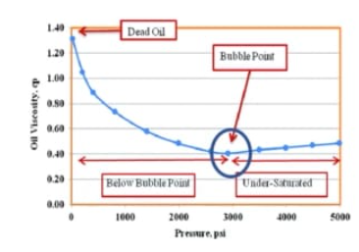
Fluid Property
The viscosity of the crude oil is one most important fluid property that affects the degree of success of a waterflooding project.
The oil viscosity plays important role in mobility ratio that, controls the sweep efficiency.
Oil has lower viscosity at saturation pressure

Slide 7
Reservoir Geometry
The areal geometry of the reservoir will influence the location of wells and number of wells.
The reservoir’s geometry will essentially dictate the methods by which a reservoir can be produced through water-injection practices.
If a water-drive reservoir is classified as an active water drive, injection may be unnecessary.

Slide 8
Reservoir Depth
Reservoir depth has an important influence on both the technical and economic aspects of a secondary recovery project.
Maximum injection pressure will increase with depth.
The cost of lifting oil from very deep wells will limit the maximum economic water–oil ratios that can be tolerated, thereby reducing the ultimate recovery factor and increasing the total project operating cost.
On the other hand, a shallow reservoir imposes a restraint on the injection pressure that can be used, because this must be less than fracture pressure.

Slide 9
Petro-physical parameters
High porosity leads to high recovery.
High permeability is encouraging.
High Capillary forces may prove to be detrimental.

Slide 10
Fluid Saturations
A high oil saturation that provides a sufficient supply of recoverable oil is the primary criterion for successful flooding operations.
Higher oil saturation at the beginning of flood operations increases the oil mobility that, gives higher recovery efficiency

Slide 11
Reservoir uniformity and Pay continuity
Substantial reservoir uniformity is one of the major physical criterions for successful waterflooding.
Areal continuity of the pay zone is also a prerequisite for a successful waterflooding project.
Breaks in pay continuity and reservoir anisotropy caused by depositional conditions, fractures, or faulting need to be identified and described before determining the proper well spanning and the suitable flood pattern orientation.

Slide 12
Primary reservoir driving mechanisms
Among the others primary reservoir driving mechanism Solution Gas Drive mechanisms generally are considered the best candidate for water floods.
Because the primary recovery will usually be low, the potential exists for substantial additional recovery by water injection.
As a general guideline, waterfloods in solution gas-drive reservoirs frequently will recover an additional amount of oil equal to primary recovery.

Slide 13
Selection of Flooding Patterns
The objective is to select the proper pattern that will provide the injection fluid with the maximum possible contact with the crude oil system.
This selection can be achieved by
Converting existing production wells into injectors.
Drilling infill injection wells.

Slide 14
When making the selection, the following factors must be considered:
Reservoir heterogeneity and directional permeability
Direction of formation fractures
Availability of the injection fluid (gas or water)
Desired and anticipated flood life
Maximum oil recovery
Well spacing, productivity, and injectivity.
Essentially four types of well arrangements are used in fluid injection projects:
Irregular injection patterns
Peripheral injection patterns(Important)
Regular injection patterns(Important)
Crestal and basal injection patterns

Slide 15
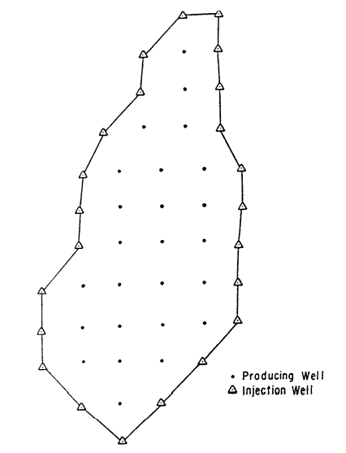
Peripheral Injection Patterns
In peripheral flooding, the injection wells are located at the external boundary of the reservoir and the oil is displaced toward the interior of the reservoir.
The peripheral flood generally yields a maximum oil recovery with a minimum of produced water.
The production of significant quantities of water can be delayed until only the last row of producers remains.
The formation permeability must be large enough to permit the movement of the injected water at the desired rate over the distance of several well spacing from injection wells to the last line of producers

Slide 16
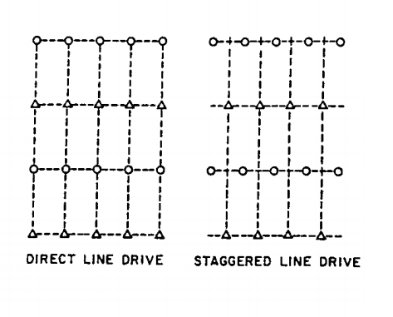
Regular Injection Patterns
Direct line drive: The lines of injection and production are directly opposed to each other.
The pattern is characterized by two parameters: a = distance between wells of the same type, and d = distance between lines of injectors and producers.
Staggered line drive: The wells are in lines as in the direct line, but the injectors and producers are no longer directly opposed but laterally displaced by a distance of a/2

Slide 17
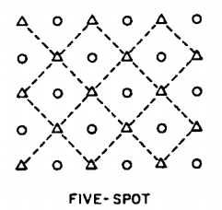
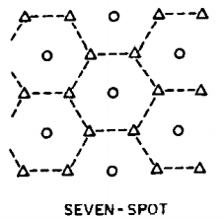
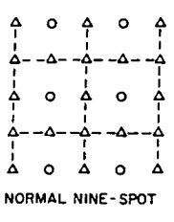
Five spot: This is a special case of the staggered line drive in which Any four injection wells thus form a square with a production well at the center.
Seven spot: The injection wells are located at the corner of a hexagon with a production well at its center.
Nine spot: The pattern essentially contains eight injectors surrounding one producer.

Slide 18
Deciding Time For Water Flood
Reservoir Oil Viscosity: Oil has lower viscosity at the saturation pressure.
Gas Saturation: Some (<10%) free gas saturation before water injection is good.
Reservoir Pressure: Higher is the pressure before water injection, better it is. It gives larger drawdown and longer life to well, which is favorable for good economics for the water flooding project.
Economical Aspects:
Cost of Injection, Cost on Injection Equipment’s, Hardware/Software, Maintenance/Service etc.
Financial Consideration: NPV, IRR, Economic analysis of the project.

Slide 19
Recovery Factor
The recoverable amount of hydrocarbon initially in place, normally expressed as a percentage.
Recovery factor of water flooded zone is :
RF=E_{A}*E_{D}*E_{VI}
where E_{A}, E_{D}, E_{VI} are the Areal Sweep Efficiency, Displacement Efficiency, Volumetric Sweep Efficiency respectively.

Slide 20
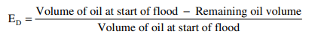
Displacement Efficiency
Displacement efficiency is the fraction of movable oil that has been recovered from the swept zone at any given time.
Improvement of displacement efficiency
Decreasing Residual oil Saturation.
Chemical flood-surfactants.
Taking advantage of gravity forces.
Oil vaporization

Slide 21
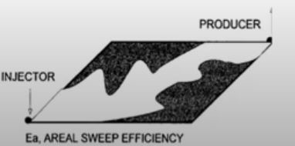
Areal Sweep Efficiency
The areal sweep efficiency E_{A} is the fractional area of the pattern that is swept by the displacing fluid.
The major factors determining areal sweep are:
Fluid mobility.
Pattern type
Areal heterogeneity.
Total volume of fluid injected

Slide 22
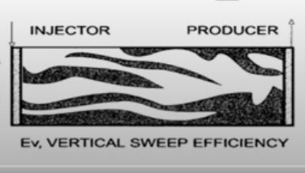
Vertical Sweep Efficiency
The vertical sweep efficiency EV is the fraction of the vertical section of the pay zone that is contacted by injected fluids.
The vertical sweep efficiency is primarily a function of:
Vertical heterogeneity
Degree of gravity segregation
Fluid mobilities’
Total volume injection

Slide 23
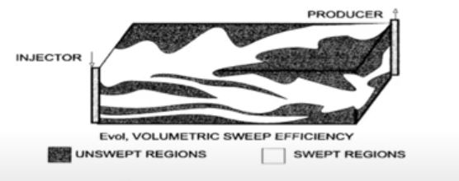
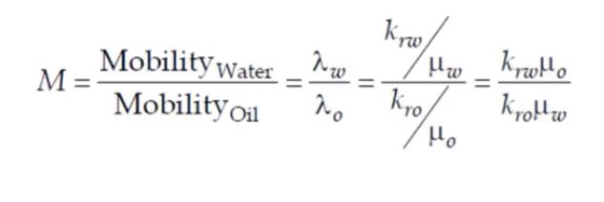
Volumetric Sweep Efficiency
The product of E_{A} E_{V} is called the volumetric sweep efficiency and represents the overall fraction of the flood pattern that is contacted by the injected fluid.
Lowering mobility ratio by increasing viscosity of displacing agent

Slide 24
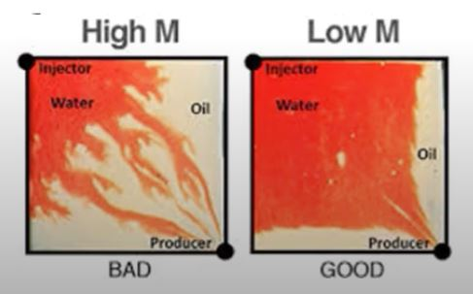
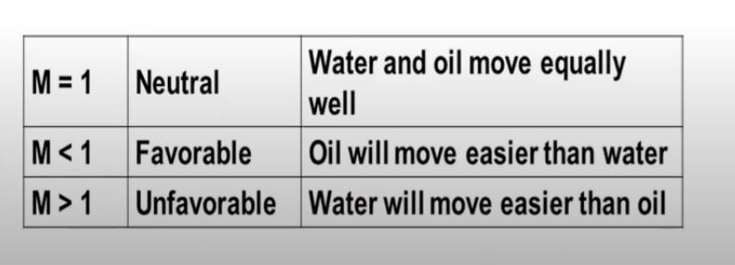

Slide 25
Waterflood Optimization Techniques
AND THEIR STUDY

Slide 26
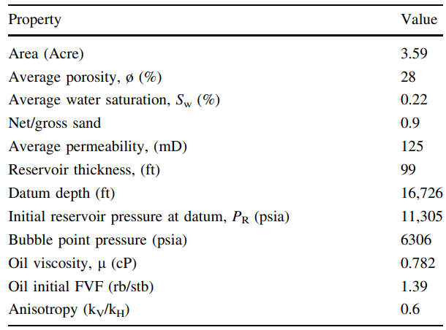
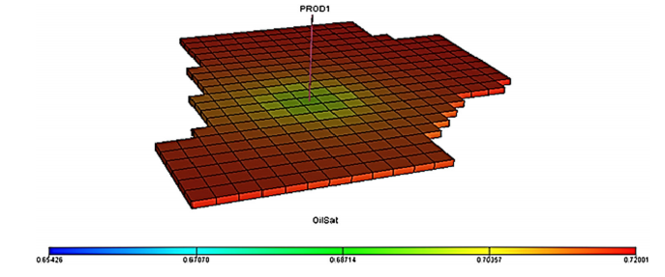
Reservoir Description
It was a good candidate for secondary recovery because:
The reservoirs have limited aquifer influx.
The reservoirs was very over-pressured and compacting and was undersaturated.
The reservoirs also have good structure relief, good connectivity and directional permeabilities.

Slide 27
Objectives
Objective functions for waterflood optimization include net pressure value (NPV), cumulative production or delay in water breakthrough/reduction in water-cut while controlling variables such as injection rate, oil production rate and/or bottom hole pressure of injectors and producers.

Slide 28
It is considered that cumulative production is affected by the zones of water injection and oil production, the pattern of waterflood, the number and type of injectors/producers.
Cumulative Oil Production = f(Zones of water injection/oil production; waterflood pattern; Number and type of injectors/producers)
Zones of Water Injection and Oil Production
Cumulative Oil Production
Number and Type of Injectors and Producers
The Pattern of Waterflood

Slide 29
Effects of zones of injection and production (ZoIP)
The cases chosen are explained below:
Case 1 (ZONES 4–5): Production was carried out from two zones—layers 3 to 4, and water was injected into the fourth and fifth zones of the reservoir—layers 4 to 5.
Case 2 (ZONE 4): For this scenario, production was carried out from two zones—layers 3 to 4, and water was injected the zone close to the water-bearing zone— layer 4
Case 3 (AQUIFER): Here, two zones of the reservoir were completed—layers 3 to 4, and water was injected in the water-bearing zone—zone 5.
NOTE: These scenarios were carried out adopting a regular five-spot pattern.

Slide 30
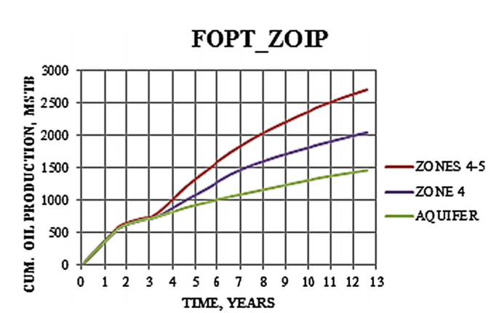
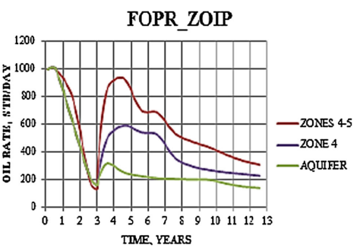
Effects of ZoIP on the field oil production (FOPT) and field oil production rate (FOPR)
ZONES 4–5 having the highest cumulative oil production for all periods after waterflooding. This is because production is largely a function of voidage. The more the zones injecting water, the higher the voidage replacement of reservoir fluids and thus, a decline in production rate is curtailed. It can also lead to very high water production.
Injection into zone 4 (ZONE 4) is seen to give higher production rates than the case of water injection into the aquifer (AQUIFER). This is because injection into oil-bearing zones in the reservoir tends to displace more oil toward the producers than injection into the aquifer.

Slide 31
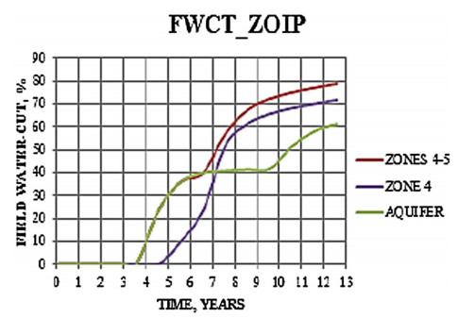
Effects of ZoIP on field water-cut (FWCT)
Also observed is that injecting water into fewer zones leads to a reduction in water production.
Injection of water into more zones of the reservoir will lead to an increase in water production.
It is seen that injection of water into zones other than the aquifer would result in high water-cut. This is because injection into such zones can cause a higher production of water with displaced oil.
Water injection into the AQUIFER is seen to have the least water production for all cases considered.

Slide 32
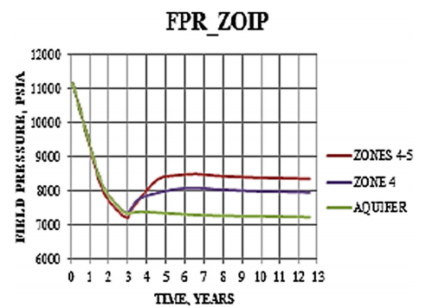
Effects of ZoIP on field pressure (FPR)
Observed from the figure is that pressure maintenance/increment is more effective when more zones of the reservoir can inject water with the scenario in which water was injected into two reservoir zones.
(ZONES 4–5) having the best pressure profile for all scenarios studied.
This is because pressure decline is largely a function of voidage. If more zones in the reservoir are injecting water, there is voidage replacement, and thus, pressure decline is arrested

Slide 33
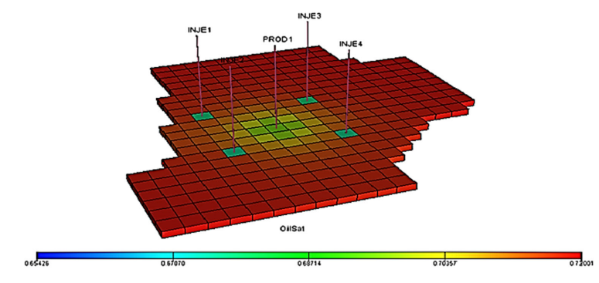
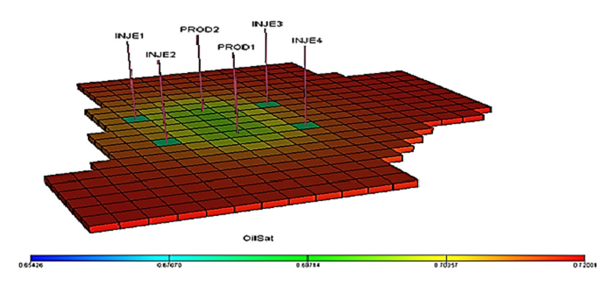
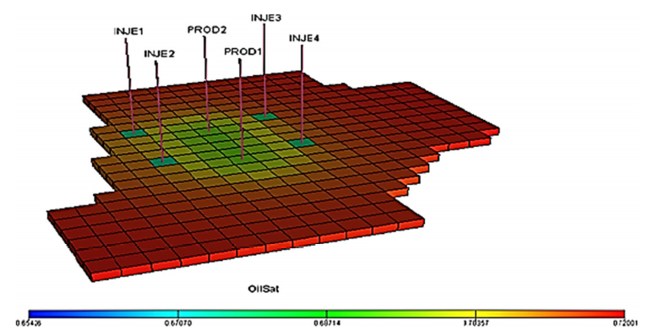
Effects of Waterflood Patterns
The scenarios analyzed included the
5-spot pattern (5_SPOT): The four injectors formed a square with the production well in the center
Direct Line drive pattern(LD): The lines of injection and production were directly opposite each other.
Staggered Line drive pattern(SLD): The injectors and producers are no longer directly opposed to each other, but laterally displaced
NOTE: All producers were completed in two zones—layers 3 to 4, and water was injected in two zones only—layers 4 to 5.

Slide 34
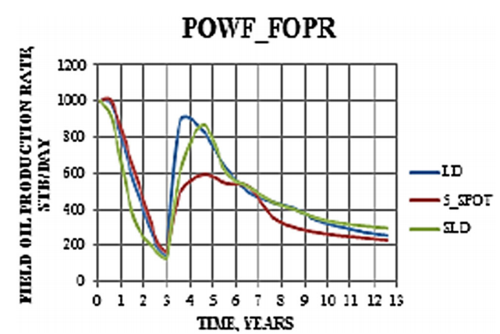
Effects of waterflood patterns on field oil production rate (FOPR)
Cases LD and SLD are observed to have higher oil production rates for periods after waterflooding.
This is because the field was adequately furnished with producers which helped drain the reservoir and injectors which ensured that oil was sufficiently displaced toward these producers, hence maintaining the high oil rate observed.
It is observed that the case 5_SPOT has the lowest oil rate of all the scenarios.
This is due to the lack of sufficient producers which would adequately drain the reservoir.
This is because the two producers have an advantage over one producer as this implies that more zones of the reservoir are available for drainage by the producers.

Slide 35
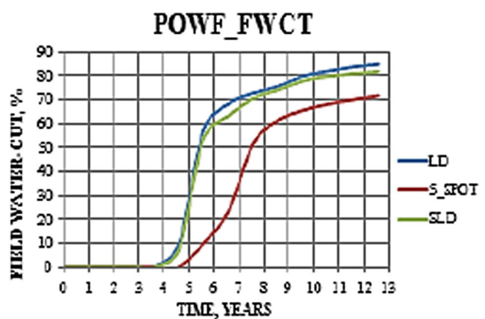
Effects of selected waterflood pattern on field watercut (FWCT)
It is observed that case LD and case SLD have similar water-cut trends which are higher than that of the five-spot waterflood pattern.
This is due to the placement of the injectors in line with the producers in distance closer than those obtainable for the five-spot waterflood pattern and allows for the faster movement of the advancing water front toward the producers and hence higher water production and earlier water breakthrough.
The five-spot waterflood scenario has the least water-cut throughout the period of simulation. This is because of the distance between the injectors and the producer in this case as compared with the other cases. This causes late water breakthrough and lower water production.

Slide 36
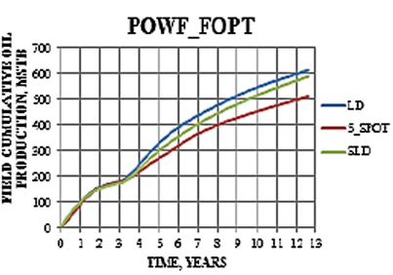
Effects of selected waterflood patterns on the field cumulative production (FOPT)
It is observed that case LD gives the highest cumulative production for all scenarios analyzed.
This is due to the efficient displacement of oil toward the producers by the injectors.
In contrast, the case 5_SPOT (regular five-spot pattern) has a low cumulative production largely due to the absence of sufficient producers to produce displaced oil.

Slide 37
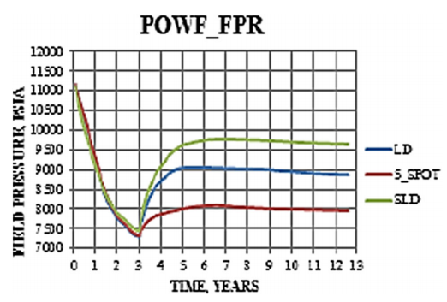
Effects of selected waterflood pattern on field pressure (FPR)
It is observed that the plots for the line drive patterns have higher pressure profiles than the five spot patterns after waterflooding.
This is largely due to the shorter distances between the injectors and the producers for these patterns as compared to the five-spot patterns.
Case SLD shows the highest pressure increment after waterflooding for all patterns analyzed.
This is because the lateral orientation of the injectors to the producers allows for effective displacement of injected water and hence better pressure maintenance.

Slide 38
Effect of number and type of wells
For scenarios involving vertical wells, the producers were completed in two zones-layers 3 to 4 and water was injected in two zones only-layers 4 to 5.
While for scenarios involving horizontal wells, the producers were drilled in layer 4 while injectors were drilled in layer 4.
Scenarios analyzed include:
Case 1 (VI_VP): This case involved the use of a total of six vertical wells—two producers and four injectors.
Case 2 (HI_VP): For this scenario, a total of four wells were employed-two horizontal injectors and two vertical producers.

Slide 39
Case 3 (VI_HP): Here, combinations of vertical and horizontal wells were employed. A total of five wells- four vertical injectors and one horizontal producer- were drilled.
Case 4 (HI_HP): In this scenario, all wells are horizontal wells. Three wells—two injectors and one producer—were drilled.
NOTE: Based on results obtained from the study on the effect of pattern of waterflood, the direct line drive pattern was adopted waterflooding commenced after three years of primary production.

Slide 40
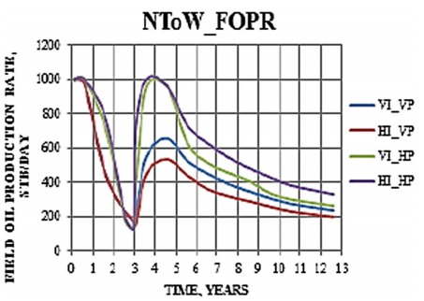
Effect of the number and type of wells on field oil production rate (FOPR)
Prior to waterflooding, it is observed that scenarios in which the producers are vertical (cases VI_VP and HI_VP) had rapidly declining flow rates as a result of the rapid depletion of oil-producing zones.
Cases VI_HP and HI_HP (scenarios with horizontal producers) are also observed to have higher production rates compared to cases VI_VP and HI_VP.
This is because for any given reservoir with good permeability anisotropy, horizontal wells have the ability to communicate with more zones in the reservoir than vertical wells and hence better oil recovery.

Slide 41
However, a reversal of this trend is observed just month before waterflooding (between years 2.5 and 3) because of rapid reduction in oil production rates of the horizontal producers due to decline in initial reservoir energy.
Upon waterflooding, it is observed that the scenarios with horizontal producers (HI_HP and VI_HP) have high field oil production rate compared to the other two scenarios in which production wells are vertical wells.
The scenario in which both injectors and producers are horizontal (case HI_HP) is seen to have the highest oil production rate for all simulation periods after waterflooding
This is because water injection by the horizontal injector into the same zone for which oil is produced (zone 4) displaces oil more efficiently toward the producers than cases with vertical injectors which involved injection of water into zones 4 and 5.
Cases with vertical producers, cases HI_VP and VI_VP are observed have the lowest production rate for all periods after waterflooding as these producers communicate with lesser zones of the reservoir

Slide 42
Finally, case HI_VP is observed to give the lowest oil production rate.
This is due to the inefficient displacement of oil by the advancing injected water as water is not injected into the same zones from with oil production is carried out.
Also, recall that the production wells are in communication with lesser zones of the reservoir when compared to scenarios involving the use of horizontal wells.

Slide 43
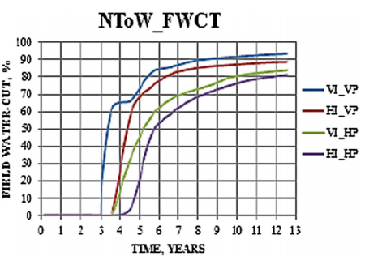
Effect of number and types of wells on field watercut (FWCT)
Upon waterflooding, water-cut for scenarios with vertical injectors, cases VI_VP and VI_HP are discovered to have the highest increase in water-cut.
This is because in reservoirs with good vertical-to-lateral anisotropy, water will flow more conveniently in the upward vertical direction due to gravity rather than laterally and leads to higher water production at the producers.
Finally, case VI_VP gives the earliest water breakthrough time as water production is observed to begin upon waterflooding.
This is because the completion of the producers close to the water-bearing zone of the reservoir creates higher tendency of early water coning.

Slide 44
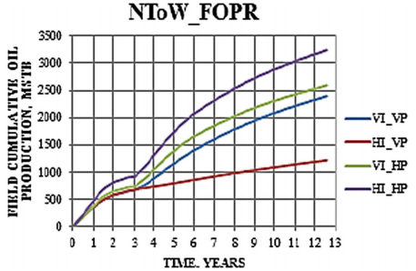
Effect of number and type of wells on field cumulative production (FOPT)
It is observed that scenario HI_HP has the highest cumulative production. This is because of horizontal producers which have the advantage of producing from more reservoir zones.
This led to the steadily increasing oil recovery experienced.
Since this scenario involves the use of horizontal injectors which are completed in the same zone as the producer, water flows to displace oil toward the producer more efficiently, and hence, more oil is drained at the producers.

Slide 45
Cases with vertical producers, cases HI_VP and VI_VP are observed to have the lowest cumulative oil production throughout simulation as these producers communicate with lesser zones of the reservoir, and hence, oil production is lesser in these scenarios.
Case HI_VP in which injectors are horizontal well and producers are vertical wells is observed to give the lowest cumulative oil production.
The use of horizontal injectors and vertical producers is not good practice as there is inefficient displacement of oil by the advancing injected water because of well orientations.
Also, the production wells in this scenario are in communication with lesser zones of the reservoir when compared to scenarios involving the use of horizontal producers

Slide 46
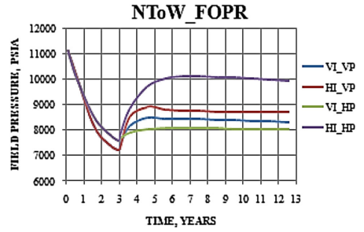
Effect of number and types of wells on average field pressure (FPR)
It is observed that HI_HP had the highest pressure increment for the waterflood operation.
This is because of the large number of zones into which water were injected.
Pressure decline is largely a function of voidage, and when more reservoir zones can inject water, there is voidage replacement and pressure decline is arrested.
The average field pressure for the scenarios which involved the use of vertical injectors (VI_VP and VI_HP) showed the lowest pressure increment for all scenarios studied.

Slide 47
Conclusions of Case Study:
The geostatistical tool of co-simulation is a reliable and efficient tool for modeling and distributing reservoir petrophysical properties in a model.
Building of multiple equiprobable realizations of reservoir properties and ranking them are an efficient approach to reservoir characterization. This approach reduces uncertainties associated with reservoir properties estimation.
The combination of generating numerous equiprobable distributions of reservoir property and using numerical simulation to evaluate fluids distribution is an extremely useful approach for reservoir performance analysis.
Water flood was optimized using an approach that considered the zones of injection and production, the pattern of water flood and the number and type of producers/injectors.

Slide 48
Mitigation of Wax deposition in wells

Slide 49
Wax deposition:
Wax deposition is one of the most challenging flow assurance issues in oil production processes.
Waxes are classified as microcrystalline and macrocrystalline waxes.
Macrocrystalline or n-paraffin waxes are the principal constituents, which have elongated structures such as rods, plates, and needles These typically consist of 20 or more carbon atoms.
Microcrystalline waxes are composed of iso-paraffin or branched-chain paraffins and naphthenes. These have smaller rounded structures.
Macrocrystalline waxes constitute approximately 80 to 90% of the total wax content

Slide 50
Causes and Effects:
CAUSES:
The wax deposition in the areas adjoining the bore, the bore face, the tubing string and the pump is the result of the cooling effect, which occurs when the oil flows from the high-pressure reservoir into the wellbore to the surface.
EFFECTS:
The wax deposition also leads to formation damage near the wellbore, reduction in permeability, changes in the reservoir fluid composition and fluid rheology due to phase separation as wax solid precipitates.
Subsea pipelines are especially vulnerable.

Slide 51
There are several established methods used for removal, some of them are listed in decreasing order of frequency of their application :
Mitigation
Mechanical Removal
Chemicals as Wax Inhibitors
Hot Oiling/Hot Watering
Microbial Treatment
Choke Cooling
Cold Flow

Slide 52
Mechanical Removal
The efficiency in gas lift wells may be enhanced by using free pistons to remove paraffin from such wells.
Use of pipeline-inspection gauges (PIGs) is a mechanical method that is the oldest and among the most widely used wax-removal techniques in the field.
Scrapers and cutters are used in well tubing to remove wax.

Slide 53
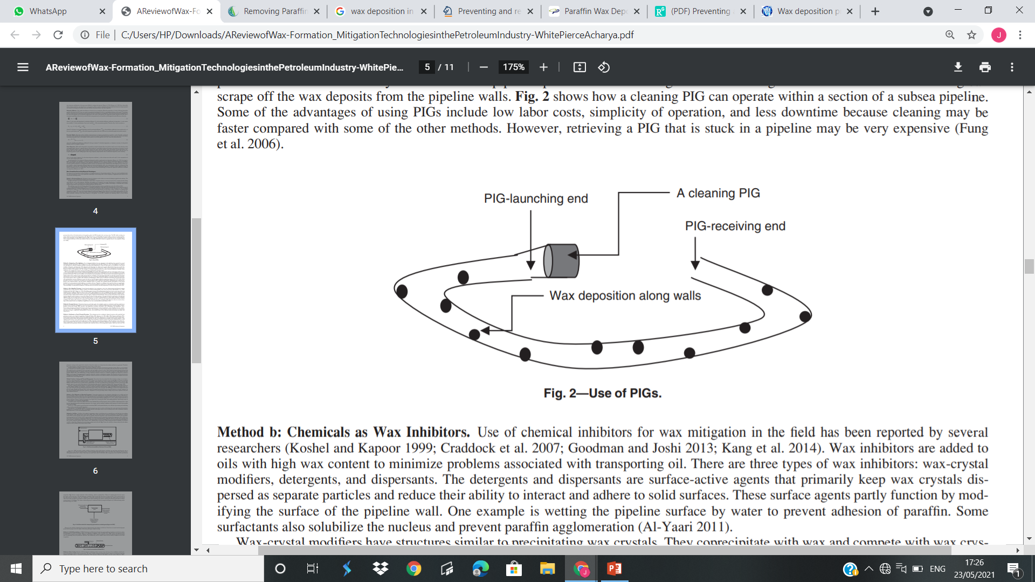
A PIG is launched from a PIG launcher, which is a section of the pipeline with a larger diameter gradually reducing to the normal diameter of the pipeline.
As the PIG is launched, the launching station is closed and the pressure-driven flow of the hydrocarbon in the pipeline pushes the PIG through to the receiving center. The PIG while traveling can scrape off the wax deposits from the pipeline walls

Slide 54
Chemicals as Wax Inhibitors
Wax inhibitors are added to oils with high wax content to minimize problems associated with transporting oil.
There are three types of wax inhibitors: wax-crystal modifiers, detergents, and dispersants.
The disadvantage of using chemical inhibitors is that they must be used before the bulk temperature of crude oil drops below the WAT.

Slide 55
Hot Oiling/Hot Watering
Hot oiling or hot watering is the method of injecting hot oil or hot water into wells in an attempt to dewax wellbores.
Hot oil or water at 150 to 300F is pumped into the casing or tubing to melt waxes.
It is one of the most-common methods used in the field.
Because the biggest advantage is perhaps associated with it being a simple method and that it may not require complicated instrumentation.

Slide 56
Wax Mitigation by Microbial Treatment
Using microorganisms for wax mitigation, although not very widely used, has been successfully used on some fields of the Mehsana Asset of Oil and Natural Gas Corporation Limited (Biswas et al. 2012).
Biosurfactant-producing bacterial cultures have been reported that aid in wax mitigation in pipelines.
Crude-oil properties were improved by lowering the WAT, thus making pipelines with flowing crude oil less susceptible to wax formation.

Slide 57
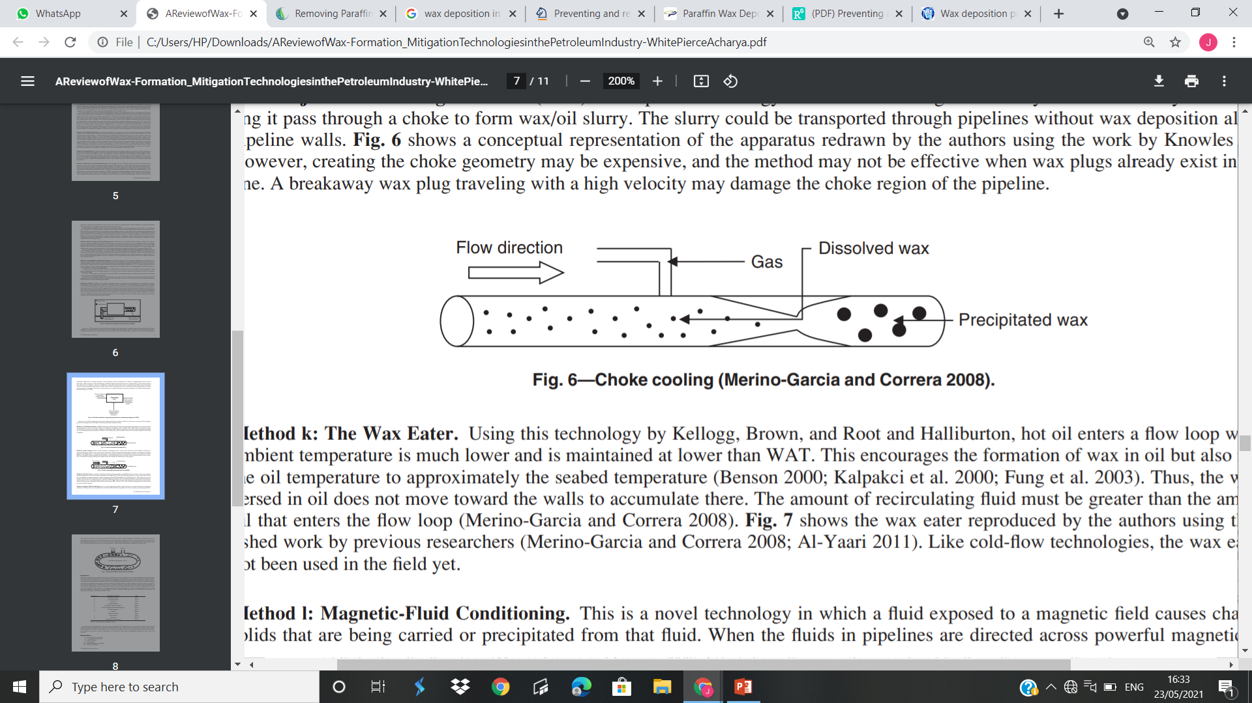
Choke Cooling
Knowles developed a technology where a stream of gas and waxy oil was suddenly cooled by letting it pass through a choke to form wax/oil slurry.
The slurry could be transported through pipelines without wax deposition along the pipeline walls.

Slide 58
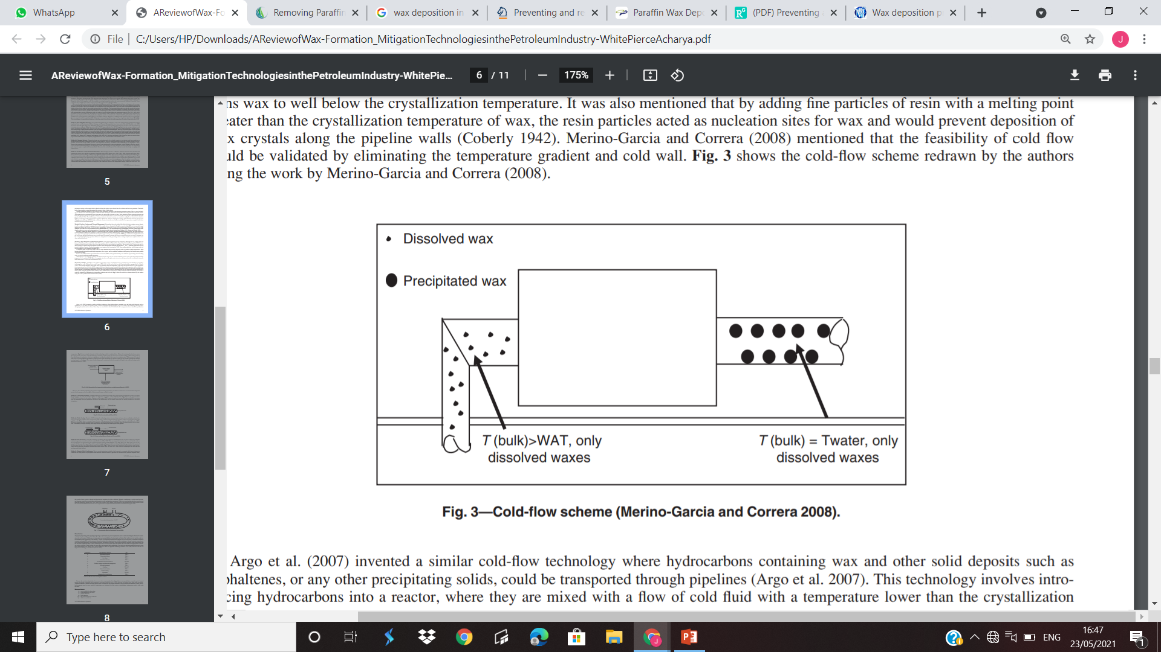
COLD FLOW
Cold flow is the method of generating a slurry of solid deposits in a controlled way such that they do not adhere to the pipeline walls.
Coberly suggested that wax deposition may be retarded by reducing the temperature of the oil that contains wax to well below the crystallization temperature.

Slide 59
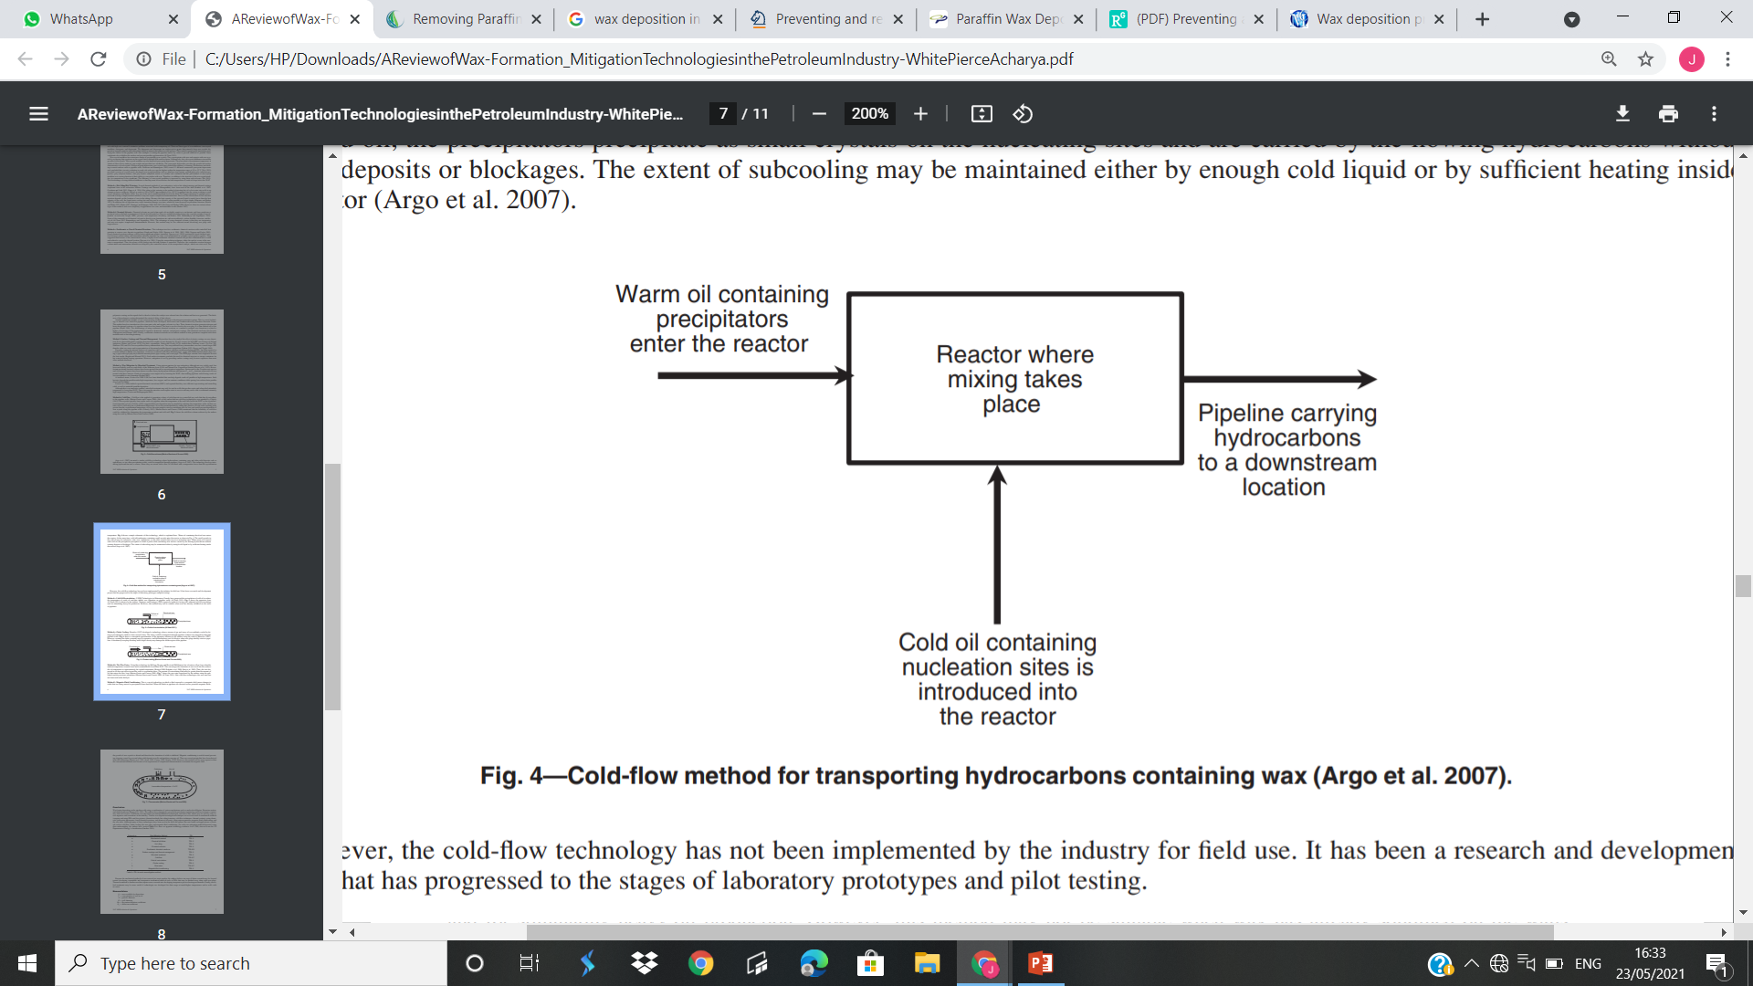
Argo et al. invented a similar cold-flow technology where hydrocarbons containing wax and other solid deposits such as asphaltenes, or any other precipitating solids, could be transported through pipelines. This technology involves introducing hydrocarbons into a reactor, where they are mixed with a flow of cold fluid with a temperature lower than the crystallization.

Slide 60
References:
Al-Yaari, M. 2011. Paraffin Wax Deposition: Mitigation & Removal Techniques. Presented at the SPE Saudi Arabia Section Young Professionals Technical Symposium, Dhahran, Saudi Arabia, 14–16 March. SPE-155412-MS. https://doi.org/10.2118/155412-MS.
Biswas, S. K., Bateja, S., Sarbhai, M. P. et al. 2012. Application of Microbial Treatment for Mitigating the Paraffin Deposition in Down Hole Tubulars and Surface Flow Lines of Wells–A Success Story. Presented at the SPE Oil and Gas India Conference and Exhibition, Mumbai, 28–30 March. SPE154662-MS. https://doi.org/10.2118/154662-MS.
Harms, H. L., Moeckly, C. R., Reed, D. et al. 1991. Oil Tool and Method for Controlling Paraffin Deposits in Oil Flow Lines and Downhole Strings. US Patent No. 5,052,491.
Misra, S., Baruah, S., and Singh, K. 1995. Paraffin Problems in Crude Oil Production and Transportation: A Review. SPE Prod & Fac 10 (1): 50–54. SPE-28181-PA. https://doi.org/10.2118/28181-PA.
Wei, B. 2015. Recent Advances on Mitigating Wax Problem Using Polymeric Wax Crystal Modifier. J. Petrol. Explor. Prod. Technol. 5 (4): 391–401. https://doi.org/10.1007/s13202-014-0146-6. Woo, G. T., Garbis, S. J., and Gray, T. C. 1984. Long-Term Control of Paraffin Deposition. Presented at the SPE Annual Technical Conference and Exhibition, Houston, 16–19 September. SPE-13126-MS. https://doi.org/10.2118/13126-MS.

Slide 61
References:
Precious Ogbeiwi1, Yetunde Aladeitan, Dickson Udebhulu 2017, An approach to waterflood optimization: Case study of the reservoir X

Slide 62
Thanks!
Presentation by:
JATIN R PUTHRAN 18JE0379
LOKESH KUMAR CHAUDHARY 18JE0448
SAURABH RAJ 18JE0747

